Slide 1

TEAM 3 - PRESENTS
ADVANCED SKIN DISEASEs DIAGNOSIS
1

Slide 2

CONTENT
INTRODUCTION
PROJECT OVERVIEW
MILESTONES
TRAINED AND TESTED MODELS
MACHINE LEARNING MODEL
FINAL OUTPUT
CONCLUSION
TEAM MEMBERS
2

Slide 3
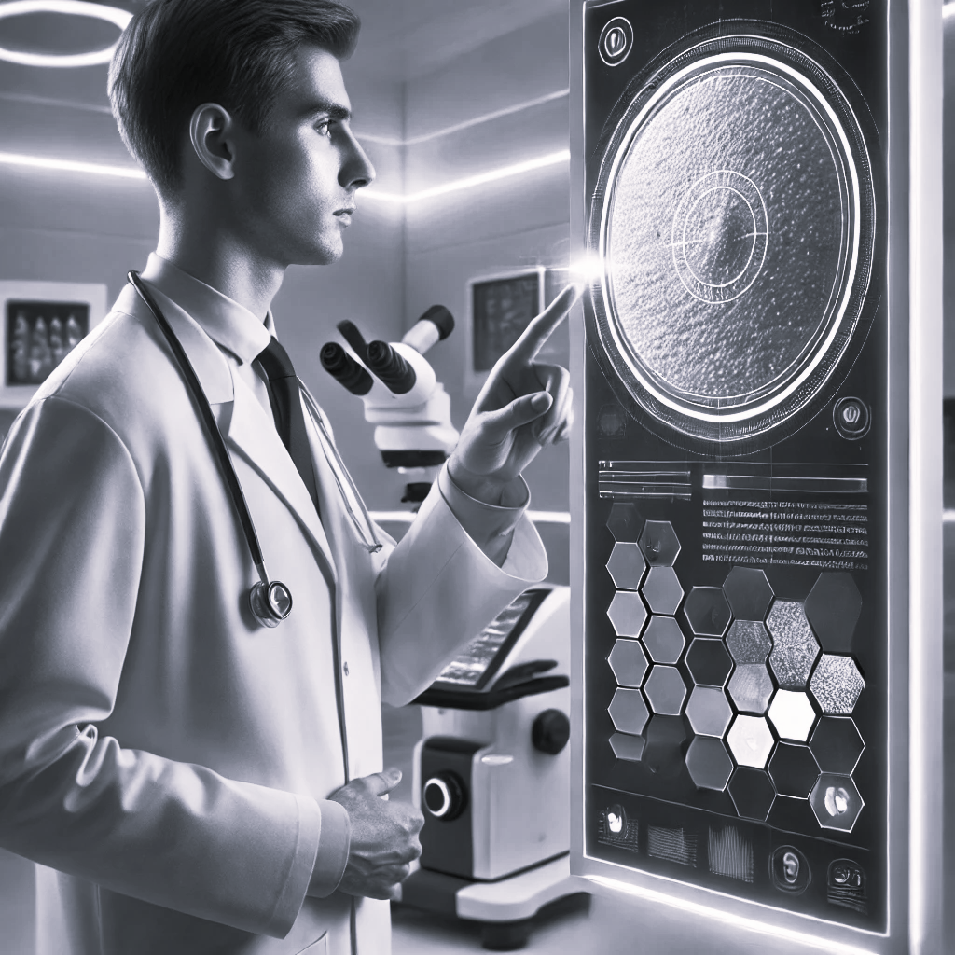
INTRODUCTION
Skin diseases affect millions globally, requiring timely and accurate diagnosis for effective treatment. Traditional diagnosis relies heavily on manual visual assessment, which can be subjective and time-consuming. Our project, Advanced Skin Disease Diagnosis using Machine Learning, aims to address these challenges by leveraging machine learning and image processing to detect and diagnose skin conditions quickly and accurately. This innovative approach enhances diagnostic accuracy and provides scalable solutions, making quality dermatological care more accessible to diverse populations.
3

Slide 4
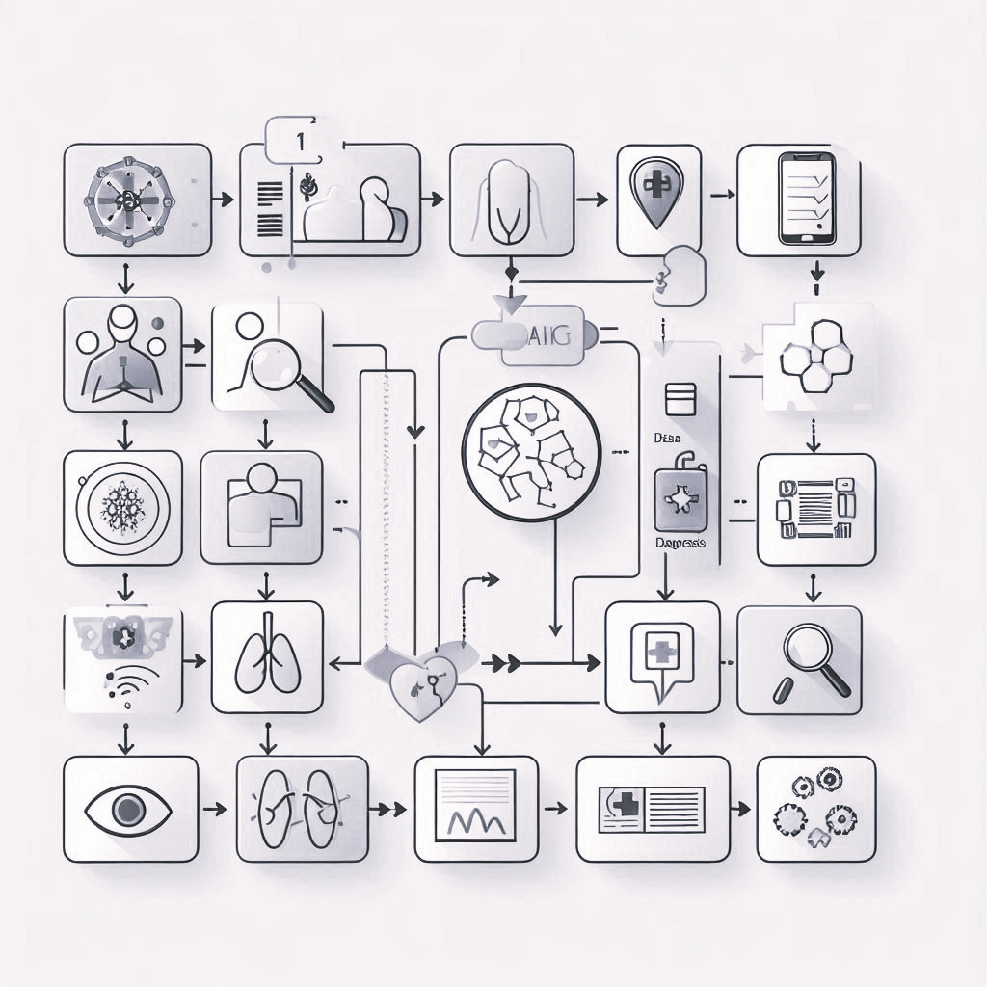

PROJECT OVERVIEW
CUSTOMER FEATURES
Create Account: Users can easily create an account to access personalized diagnosis features securely.
Login: Secure login functionality ensures data privacy and allows users to access their account for consistent, personalized interaction with the application.
Input Page: The input page allows users to upload images of skin conditions. Our Advanced machine learning algorithms process these images to identify and diagnose potential skin diseases.
View Page: The view page displays diagnostic results, including identified skin conditions and relevant details. Users can review their diagnostic history and access insights for better understanding and management of skin health.
4

Slide 5

Milestone 1
Milestone 1: Development of Customer Features
1. Create Account and Login Functionalities
User Registration: Implemented secure account creation with username, email, and password.
Login: Enabled users to authenticate via username and password for secure access.
Session Management: Ensured persistent sessions for users once logged in.
2. Image Upload Feature
User Submission: Users can upload images of their skin conditions for analysis.
Image Validation: Ensures only valid image formats (JPEG, PNG) and proper file sizes are accepted.
3. View Page for Results
Diagnostic Display: Displays the analysis results and insights from the image uploaded by the user.
5

Slide 6
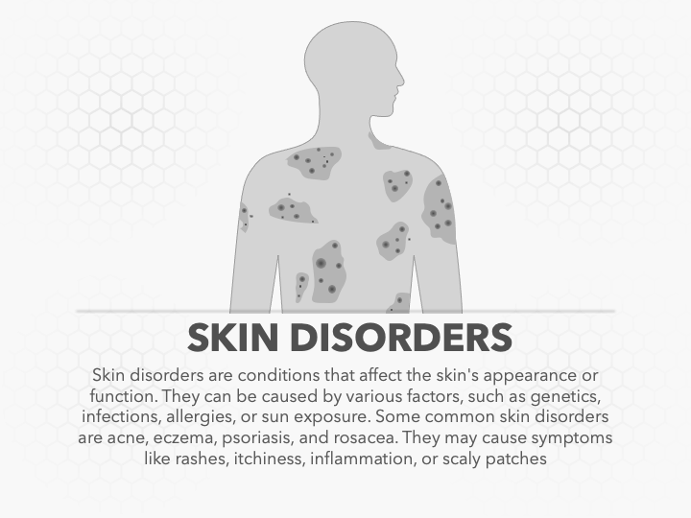
Milestone 2
Milestone 2: Mastering Image Processing with OpenCV
1. Foundational and Advanced OpenCV Skills
OpenCV Mastery: Gained a comprehensive understanding of OpenCV, a powerful image processing library.
Medical Image Analysis Focus: Applied OpenCV techniques specifically tailored for medical image analysis tasks.
2. Image Pre-processing and Filtering
Enhancing Image Quality: Used techniques like noise reduction, histogram equalization, and smoothing to improve image clarity.
Contrast Adjustment: Enhanced visibility of skin lesions and abnormalities for better diagnostic outcomes.
3. Contour Detection and Segmentation
Isolating Regions of Interest: Applied contour detection to identify and highlight skin lesions or affected areas.
Segmentation: Separated the area of interest (skin condition) from the rest of the image for accurate analysis and diagnosis.
6

Slide 7
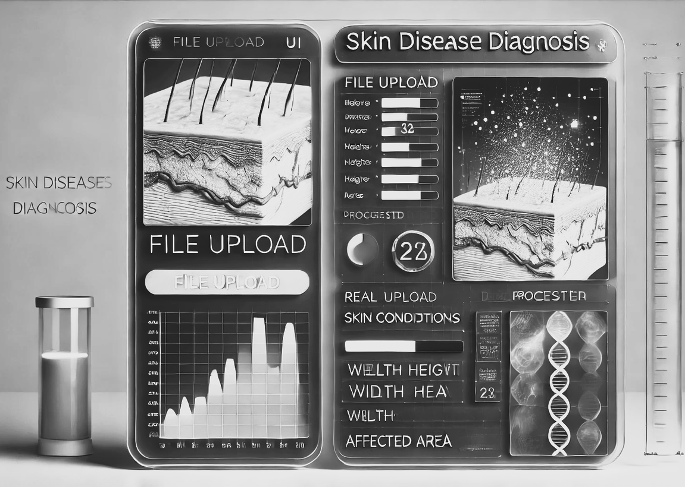
Milestone 3
Milestone 3: UI Integration of Image Processing
This milestone bridges backend image processing with a user-friendly interface, enabling real-time analysis of user-uploaded images.
Key Achievements:
Real-Time Processing: Integrated OpenCV in the backend to analyze images instantly after upload.
User-Friendly Upload: Designed an intuitive UI for uploading skin condition images with validation for format and size.
Advanced Analysis: Utilized the Canny Edge Detection Algorithm to detect and isolate affected areas.
Dimensional Insights: Measured and displayed the size and extent of skin conditions directly in the UI.
Seamless Integration: Enabled smooth interaction between the frontend and backend, delivering results quickly and clearly.
7

Slide 8
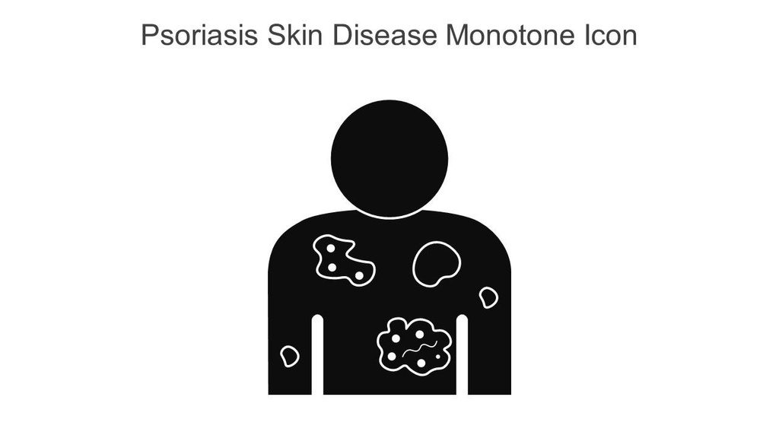
Milestone 4
Milestone 4: Integration of Voting Ensemble Model and Final Implementation
Model Training and Deployment:
Developed a Voting Ensemble Model combining Random Forest, SVM, and Logistic Regression.
Achieved 80% accuracy for skin condition classification.
2. Backend Integration:
Linked the model with OpenCV for real-time analysis of user-uploaded images.
Features extracted from processed images are classified by the ensemble model.
3. Real-Time Functionality:
Users upload images through the UI.
The system processes the image, extracts features, classifies the condition, and displays results.
4. Final Outcome:
Delivered a comprehensive solution combining machine learning and image processing for accurate diagnosis and insights.
8

Slide 9
TRAINING AND TESTING mOdel
We experimented with multiple machine learning models to classify skin conditions, including:
Logistic Regression: Achieved an accuracy of 47%.
Random Forest: Achieved an accuracy of 55%.
SVM (RBF Kernel): Achieved an accuracy of 72%.
Despite careful hyperparameter tuning, the models struggled with the inherent complexity of the dataset, influenced by factors such as:
Variability in skin condition appearances.
Differences in lighting and image quality.
These experiments provided:
Valuable insights into the performance of individual models.
A clear direction to explore more advanced techniques like ensemble modeling to improve accuracy and reliability.
9

Slide 10
Machine Learning mOdel
For this project, we implemented Voting Ensemble Model to improve prediction accuracy. This model combines the strengths of multiple machine learning algorithms by aggregating their predictions to make a final decision. The ensemble was trained on labeled data and achieved an accuracy of 80%, significantly improving the performance over individual models.
Base Models: The ensemble combined three robust classifiers:
Random Forest - Known for its ability to handle non-linear data and prevent overfitting.
Support Vector Machine (SVM RBF Kernel) - Effective for high-dimensional spaces and maintaining a clear margin of separation.
XGBoost (Extreme Gradient Boosting) - It is a powerful machine learning algorithm based on decision trees.
10

Slide 11
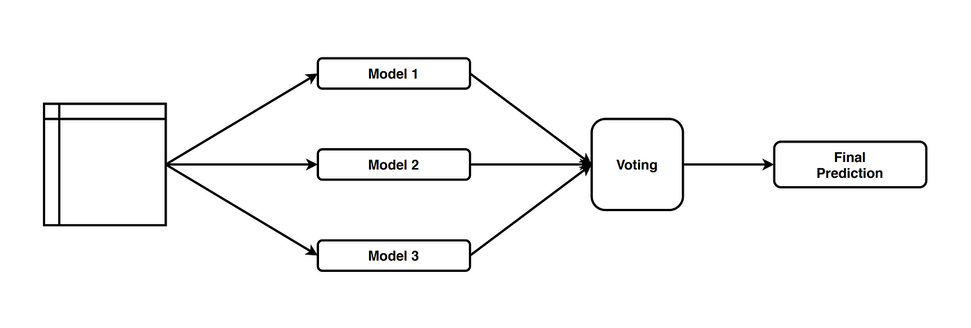
VOTING ENSEMBLE mOdel
The Voting Ensemble is a machine learning technique that combines multiple models to improve prediction accuracy. It works by training several different models (such as Random Forest, SVM, and XGBoost) on the same dataset. Each model then makes its own predictions, and the final prediction is determined by a majority vote (in classification tasks).
Hard Voting: The class predicted by the majority of models is chosen as the final output.
Soft Voting: The predicted probabilities from all models are averaged, and the class with the highest average probability is selected.
11

Slide 12
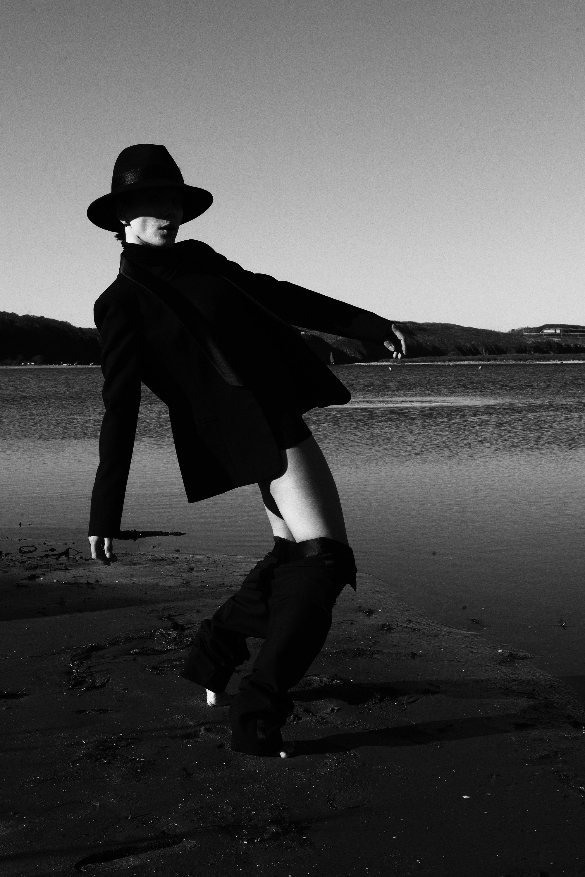

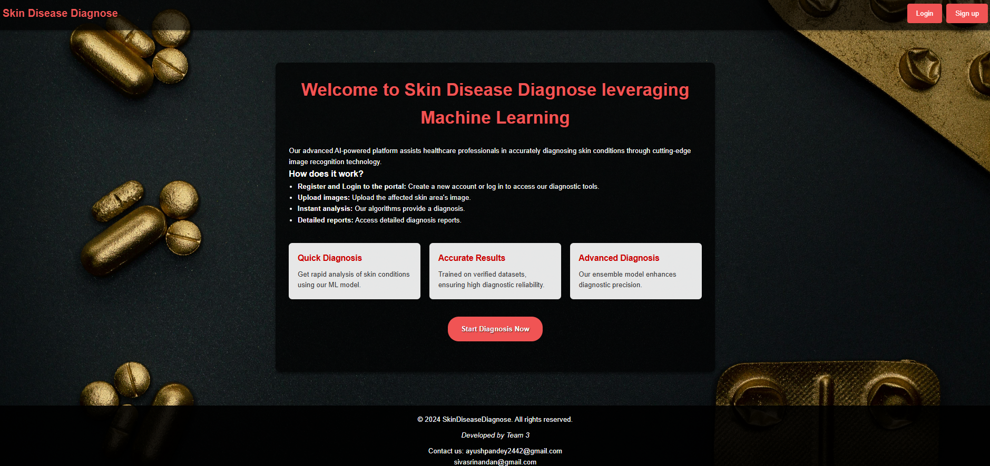
Home page
12

Slide 13
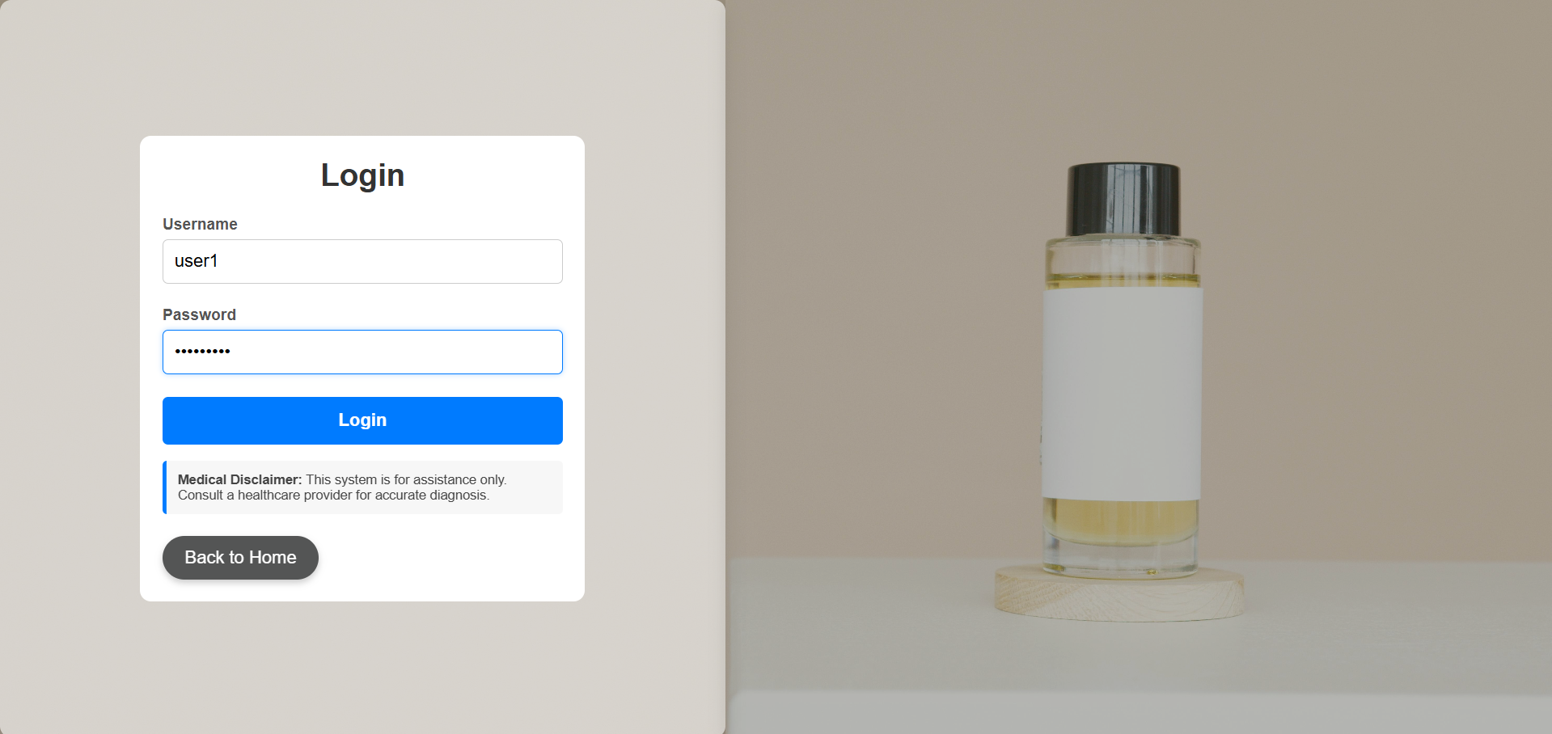
LOGIN PAGE
13

Slide 14
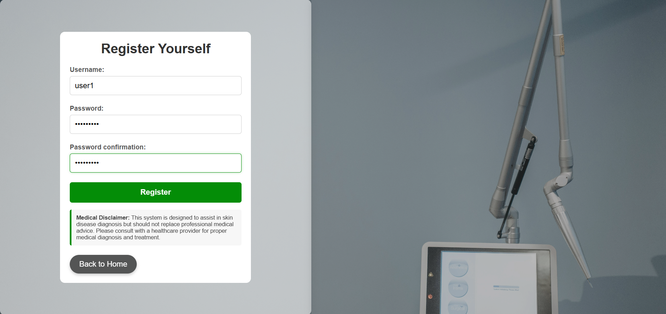
Registration page
14

Slide 15
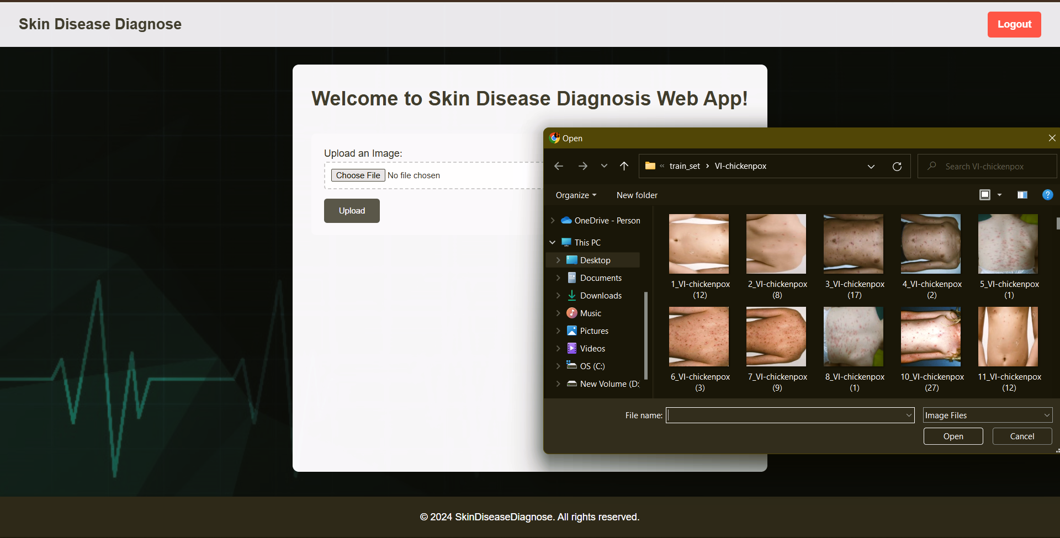
PROFILE page
15

Slide 16
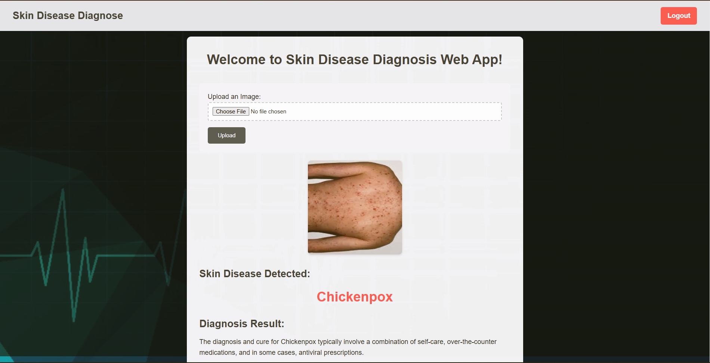
IDENTIFIED DISEASE AND DIAGNOSIS
16

Slide 17
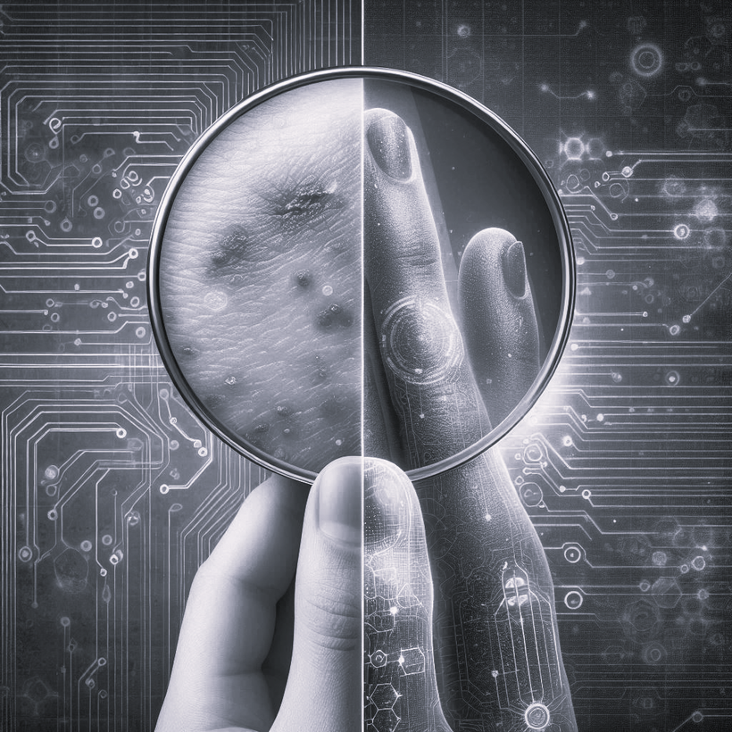
Conclusion
The Advanced Skin Disease Diagnosis project leverages Machine Learning and OpenCV to make skin disease identification faster, more accurate, and accessible. By implementing OpenCV for image processing, we’ve enhanced the accuracy of skin disease identification directly from image uploads, creating a powerful tool that empowers users with reliable diagnostic insights. This approach holds significant potential to transform dermatological care by providing scalable, efficient tools for early detection and intervention in skin diseases.
17

Slide 18
TEAM - 3
AYUSH PANDEY
MORAM HARI NAGA SIVA SRI NANDAN
18

Slide 19
Thank You
19

